Slide 1
Undecidable Problems
Costas Busch - LSU

Slide 2
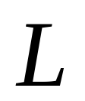


Recall that:
A language is decidable,
if there is a Turing machine (decider)
that accepts and halts on every input string
Decision
on halt
Turing Machine
YES
Accept
Input
string
Decider for
NO
Reject
Costas Busch - LSU

Slide 3
Undecidable Language
There is no decider for :
there is no Turing Machine
which accepts
and halts on every input string
(the machine may halt and decide for some input strings)
Costas Busch - LSU

Slide 4
For an undecidable language,
the corresponding problem is
undecidable (unsolvable):
there is no Turing Machine (Algorithm)
that gives an answer (yes or no)
for every input instance
(answer may be given for some input instances)
Costas Busch - LSU

Slide 5


We have shown before that there are
undecidable languages:
Turing-Acceptable
Decidable
is Turing-Acceptable and undecidable
Costas Busch - LSU

Slide 6
We will prove that two particular problems
are unsolvable:
Membership problem
Halting problem
Costas Busch - LSU

Slide 7





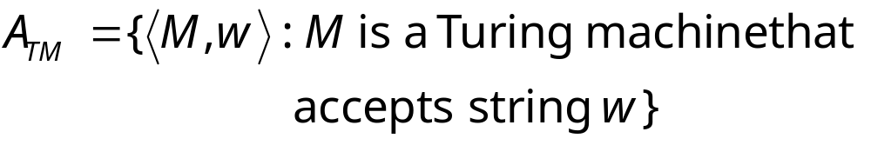
Membership Problem
Input:
Turing Machine
String
Question:
Does accept ?
Corresponding language:
Costas Busch - LSU

Slide 8
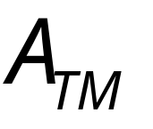
Theorem:
is undecidable
(The membership problem is unsolvable)
Proof:
Basic idea:
We will assume that is decidable;
We will then prove that
every Turing-acceptable language
is also decidable
A contradiction!
Costas Busch - LSU

Slide 9
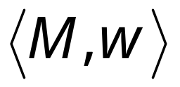
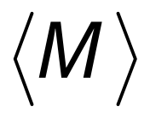


Suppose that is decidable
Input
string
Decider
for
YES
accepts
NO
rejects
Costas Busch - LSU

Slide 10

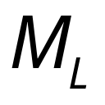
Let be a Turing recognizable language
Let be the Turing Machine that accepts
We will prove that is also decidable:
we will build a decider for
Costas Busch - LSU

Slide 11

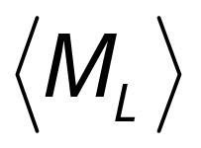

String description of
This is hardwired and copied on the tape next to
input string s, and then the pair is input to H
Decider for
Decider for
YES
accept
machine
(and halt)
accepts ?
NO
reject
Input
string
(and halt)
Costas Busch - LSU

Slide 12
Therefore,
is decidable
Since is chosen arbitrarily, every Turing-Acceptable language is decidable
But there is a Turing-Acceptable language
which is undecidable
Contradiction!!!!
END OF PROOF
Costas Busch - LSU

Slide 13
We have shown:
Undecidable
Decidable
Costas Busch - LSU

Slide 14
We can actually show:
Turing-Acceptable
Decidable
Costas Busch - LSU

Slide 15
is Turing-Acceptable
Turing machine that accepts :
1. Run on input
2. If accepts
then accept
Costas Busch - LSU

Slide 16
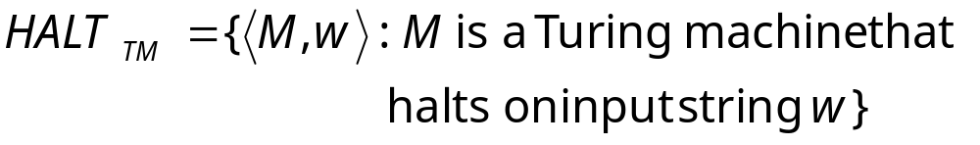
Halting Problem
Input:
Turing Machine
String
Question:
Does halt while
processing input string ?
Corresponding language:
Costas Busch - LSU

Slide 17

Theorem:
is undecidable
(The halting problem is unsolvable)
Proof:
Basic idea:
Suppose that is decidable;
we will prove that
every Turing-acceptable language
is also decidable
A contradiction!
Costas Busch - LSU

Slide 18




Suppose that is decidable
Input
string
halts on
input
YES
Decider for
NO
doesn’t halt
on input
Costas Busch - LSU

Slide 19
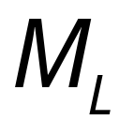
Let be a Turing-Acceptable language
Let be the Turing Machine that accepts
We will prove that is also decidable:
we will build a decider for
Costas Busch - LSU

Slide 20
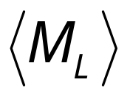

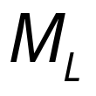

Decider for
Decider for
NO
reject
halts on ?
and halt
YES
Input
string
halts
and accepts
accept
Run
with input
and halt
halts
and rejects
reject
and halt
Costas Busch - LSU

Slide 21
Therefore,
is decidable
Since is chosen arbitrarily, every Turing-Acceptable language is decidable
But there is a Turing-Acceptable language
which is undecidable
Contradiction!!!!
END OF PROOF
Costas Busch - LSU

Slide 22
An alternative proof
Theorem:
is undecidable
(The halting problem is unsolvable)
Proof:
Basic idea:
Assume for contradiction that
the halting problem is decidable;
we will obtain a contradiction
using a diagonilization technique
Costas Busch - LSU

Slide 23

Suppose that is decidable
Input
string
Decider
for
YES
halts on
NO
doesn’t
halt on
Costas Busch - LSU

Slide 24

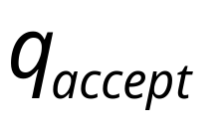

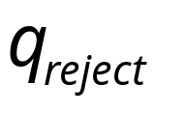
Looking inside
Decider for
YES
Input string:
halts on ?
NO
Costas Busch - LSU

Slide 25





Construct machine :
Loop forever
YES
halts on ?
NO
If halts on input Then Loop Forever
Else Halt
Costas Busch - LSU

Slide 26


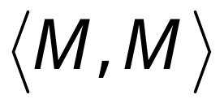

Construct machine :
Copy
on tape
If
halts on input
Then loop forever
Else halt
Costas Busch - LSU

Slide 27
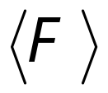
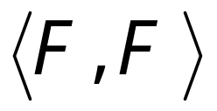



Run with input itself
Copy
on tape
If
halts on input
Then loops forever on input
Else halts on input
CONTRADICTION!!!
END OF PROOF
Costas Busch - LSU

Slide 28
We have shown:
Undecidable
Decidable
Costas Busch - LSU

Slide 29
We can actually show:
Turing-Acceptable
Decidable
Costas Busch - LSU

Slide 30
is Turing-Acceptable
Turing machine that accepts :
1. Run on input
2. If halts on
then accept
Costas Busch - LSU

Slide 31
We showed:
Turing-Acceptable
Decidable
Costas Busch - LSU

